Slide 1
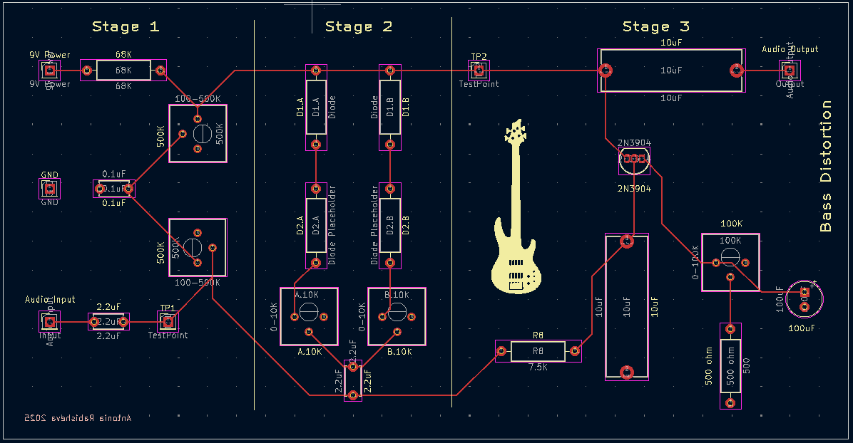
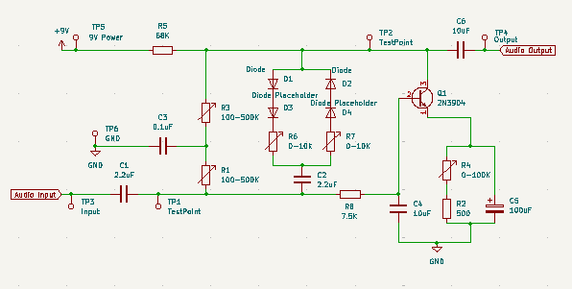
MPI Lead: Toni
Transistors in Analog Design Bass Distortion

Slide 2
CYMBAL
PRODUCT OVERVIEW
Terminology & Concepts
Audio Amplifier | A circuit that increases the amplitude of low-power audio signals to a level suitable for driving loudspeakers, usually including filters in their design for better sound reproduction
Filter | A circuit that selectively allows signals of certain frequencies to pass while attenuating others. It's commonly used to remove unwanted noise or to separate different frequency components in a signal
Amplification vs Switching | In BJT transistors, amplification occurs when the transistor operates in the active region, where it linearly increases the input signal's amplitude. In contrast, switching uses the transistor in either cutoff (off) or saturation (on) regions, acting like an electronic on/off switch rather than varying signal strength.
AC vs DC | AC (Alternating Current) is a signal that constantly changes direction and varies in voltage over time, often forming a wave-like shape such as a sine wave. DC (Direct Current) is a flat, constant signal that stays at the same voltage level
DC Offset | Refers to biasing of transistors -> A constant DC voltage needs to be set and applied to the base to ensure the transistor operates within the correct region (active in our case)
Clipping | Clipping, in relation to diodes, occurs when diodes are used in a circuit to limit the voltage of a signal by cutting off (or "clipping") parts of the waveform that exceed certain voltage levels. This creates a flattened top or bottom of the signal
Feedback | Feedback in a BJT transistor circuit involves routing a portion of the output signal back to the input to influence the transistor's behavior. Can be negative or positive.
Notes:
Note:
Our audio amplifier will not be suitable for driving loudspeakers (due to loading considerations, to be discussed later).
We will be designing a few various filters into our circuit today (high pass, distortion, etc)
The type of transistor we will be using today is a BJT. Amplification through transistors is used most often in analog applications, while switching is used most often in digital applications

Slide 3
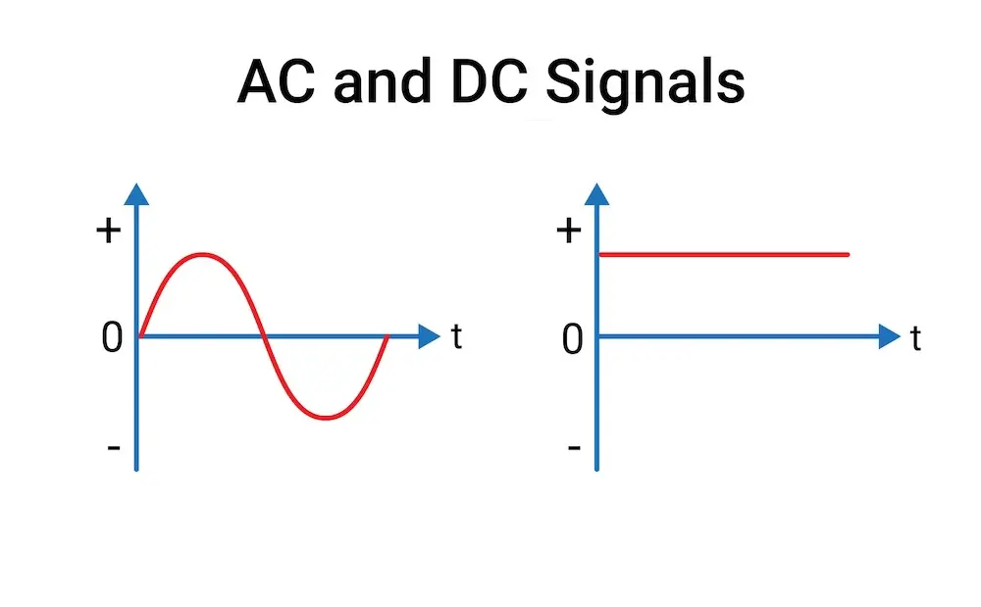
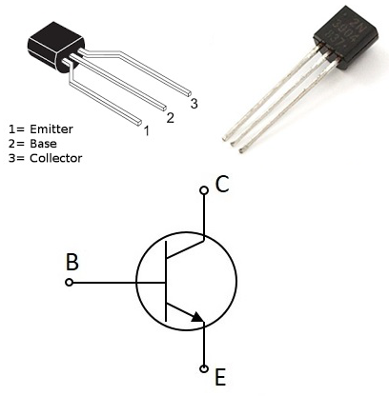
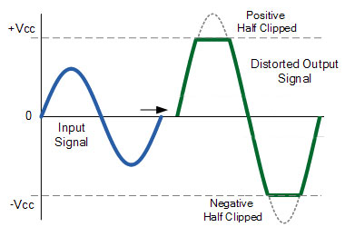
NPN BJT Transistor
Clipping

Slide 4
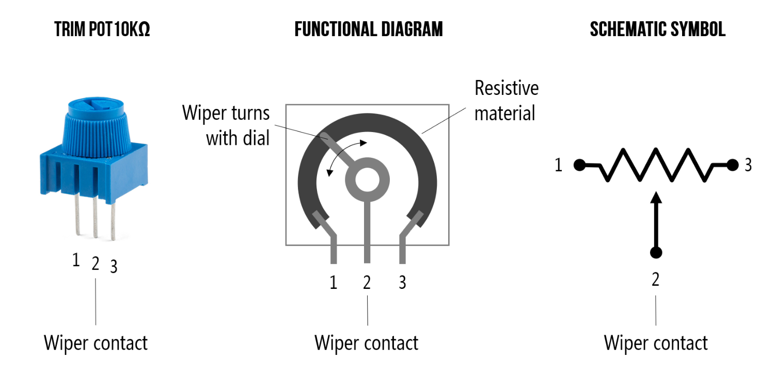
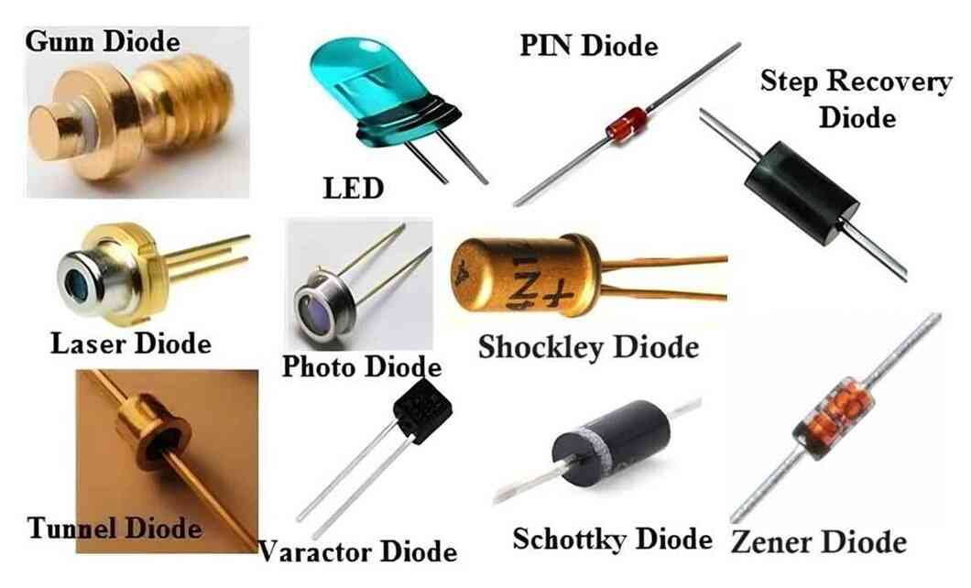
Potentiometer
Diodes

Slide 5
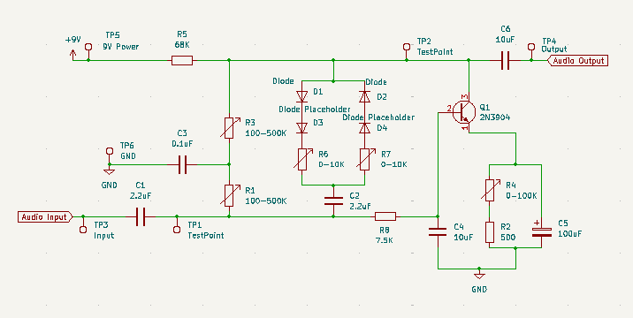

Slide 6
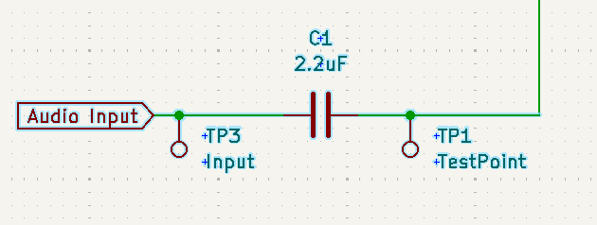
CYMBAL
PRODUCT OVERVIEW
Part 1: Input
The input is a small AC voltage signal with a frequency of 60Hz - 250Hz
High pass filter -> why include it and how does this work?
Test points -> why are these important?

Slide 7
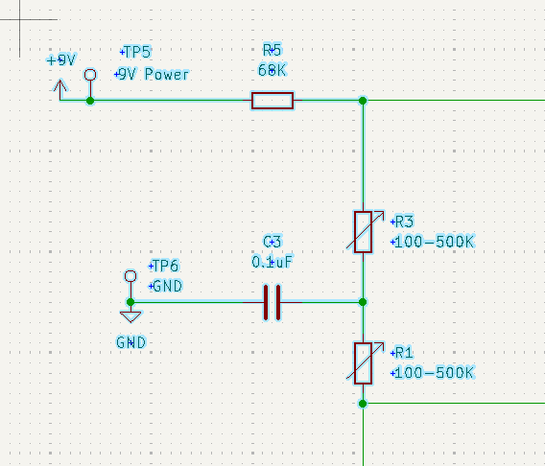
CYMBAL
PRODUCT OVERVIEW
Part 2: DC Offset + Bias
R5 -> Connects 9V to the R3, R1 junction, forming a voltage divider that sets the DC offset for the base of the transistor
R3, R1 -> Adjustable voltage divider
C3 -> Used for AC coupling (ensures DC bias is stable by shunting AC noise signals)

Slide 8
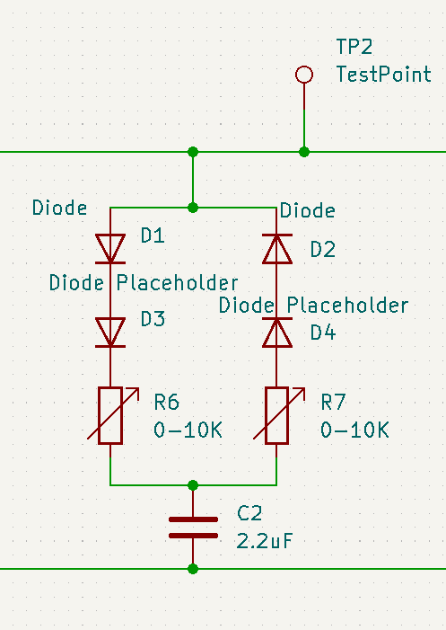
CYMBAL
PRODUCT OVERVIEW
Part 3: Clipping
Left branch -> Clips positive values of signal (AC) waveform
Right branch -> Clips negative values of signal (AC) waveform
↑ diodes = ↑ voltage threshold = ↓ clipping
Adjustable resistor -> sloped clipping
C2 -> AC coupling
Blocks DC signal from clipping branches
Passes AC signal to base of the transistor
Ensures DC signals from clipping branches don’t affect bias voltage divider from previous stage

Slide 9
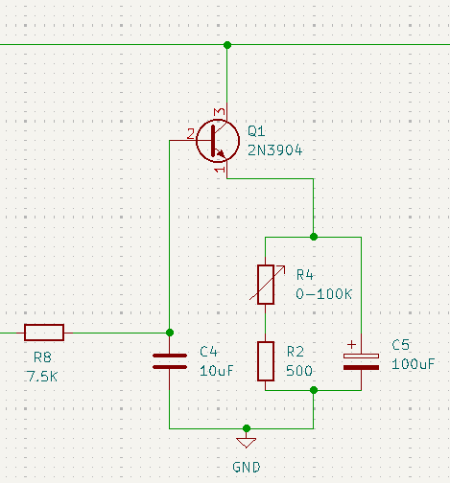
CYMBAL
PRODUCT OVERVIEW
Part 4: Amplification
Transistor -> Biased in active region, it acts as an amplifier
Amplifies AC signal on base
R8 -> Limits base current going into Q1 (protection: think bass guitar) and, with C2, creates a low-pass filter
Negative feedback loop:
C4 -> ↑ signal frequency = ↑ shunted to ground = ↓ gets amplified
R4, R2 -> ↓ voltage drop across transistor (V=IR) = ↓ amplification of signal
C5 -> in parallel with R4 + R2…
↑ signal frequency = capacitor -> short = ↑ voltage drop across transistor = ↑ amplification
C
B
E

Slide 10
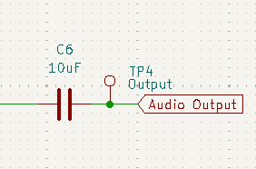
CYMBAL
PRODUCT OVERVIEW
Part 5: Output
C6 ->AC coupling capacitor that blocks any DC offset present at the collector of the transistor while only passing the amplified AC signal
Think practically: what would happen if it wasn’t there?

Slide 11

Component List
Name | Quantity | Symbol(s)
2N3904 NPN Transistor | 1 | Q1
10K pot | 2 | R6, R7
100K pot | 1 | R4
500K pot | 2 | R1, R3
100 uF cap (polarized) | 1 | C5
2.2uF cap | 2 | C1, C2
10uF cap | 2 | C4, C6
0.1 uF capacitors | 1 | C3
Male/looped pin header | 6 | TP1 - 6
Female pin header | 4 | D3 (2), D4 (2)
Resistors | 3 | R2, R5, R8
Diodes | 2 | D1, D2
For resistors -> find the indicated value (500 ohm, 68k, 7.5k) in the Hive benchtop drawers
For diodes -> this is part of the distortion you get to personalise! Pick and choose from the Hive benchtop drawers
Fabrication

Slide 12
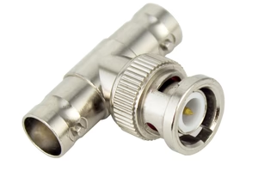
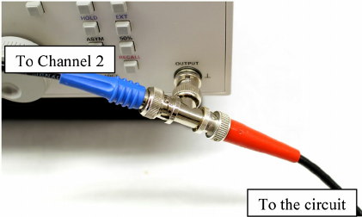
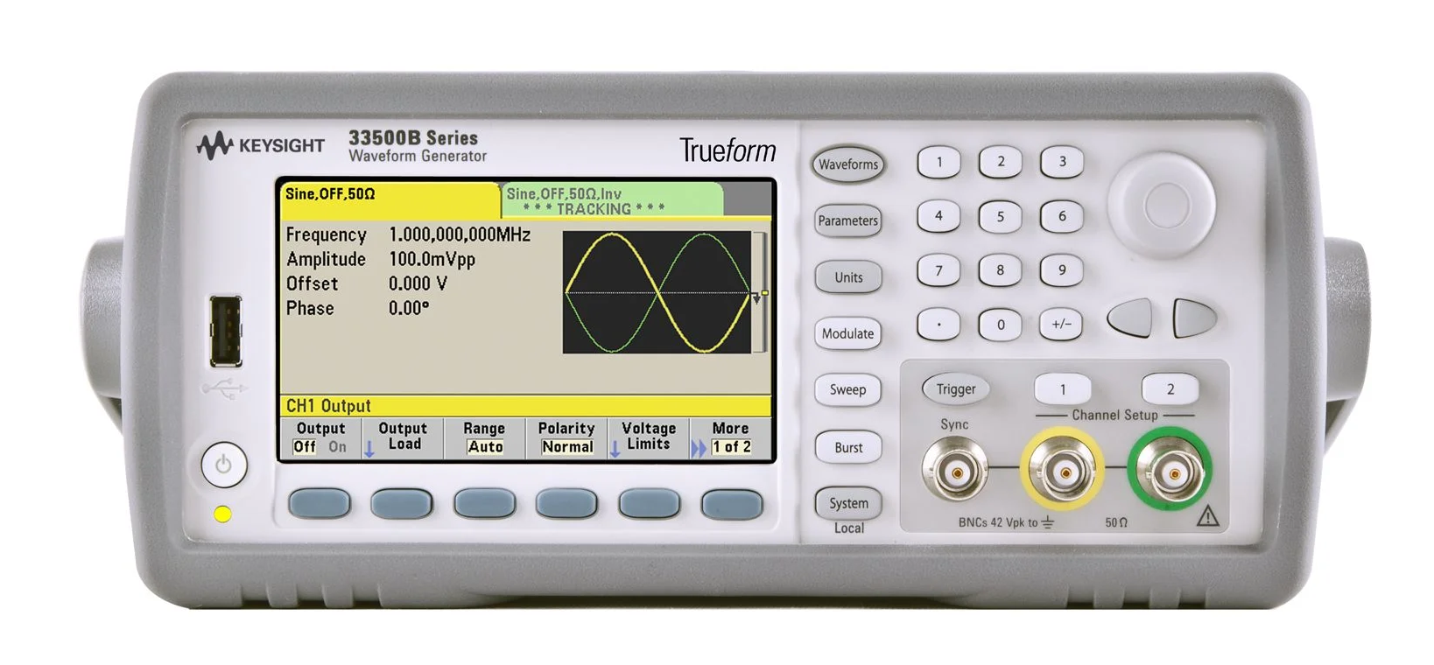
Simulation/Testing
PROBLEM & SOLUTION
WHO WE ARE
Function generator:
Use 1 BNC -> banana cable and 1 BNC -> BNC cable
Use a T-splitter on the input of the generator
Connect the BNC -> BNC cable from the T-splitter to the o-scope input
Connect other cable from T-splitter to circuit
Hook up red to input TP
Hook up black to GND TP
Set generated function to:
High-z impedance
100 Hz frequency
1 Vpp amplitude (sine wave)

Slide 13
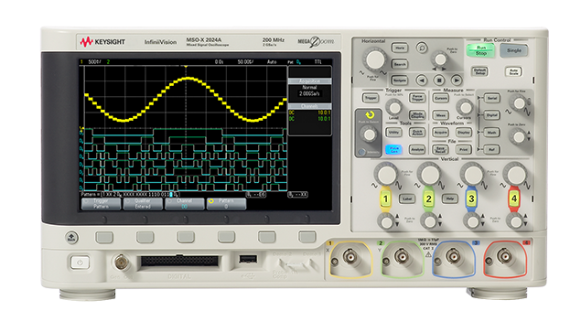
Simulation/Testing
PROBLEM & SOLUTION
WHO WE ARE
Oscilloscope:
Use 1 BNC -> banana cable
One input should have the function generator signal
Connect the BNC -> banana cable to the other input
Hook up red to output TP
Hook up black to GND TP
Turn on scope and hit Default Setup

Slide 14
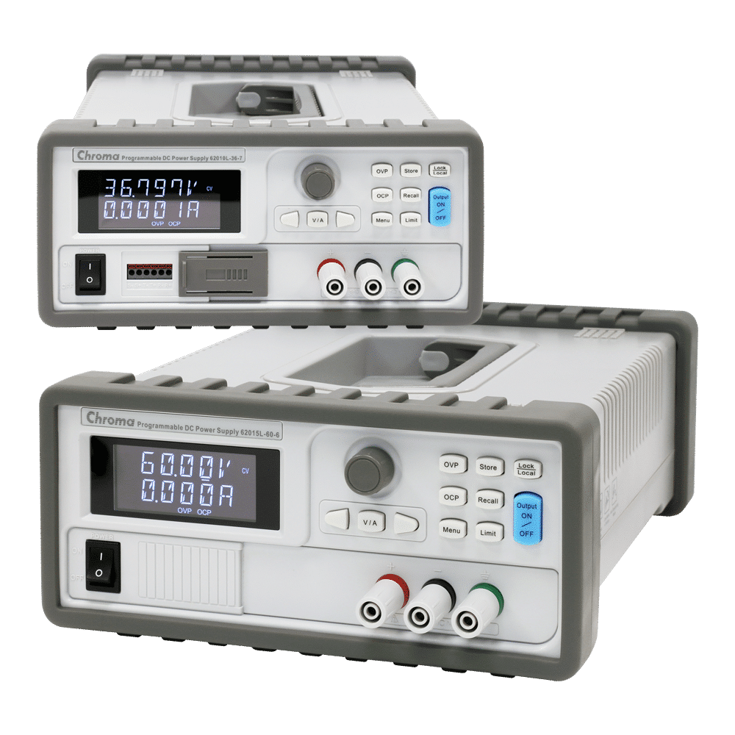
Simulation/Testing
PROBLEM & SOLUTION
WHO WE ARE
Power Supply:
2 banana -> banana cables
Connect 1 cable from +20V to +9V TP
Connect other cable from COM to GND TP
Set power supply to 9V on the 20V output

Slide 15
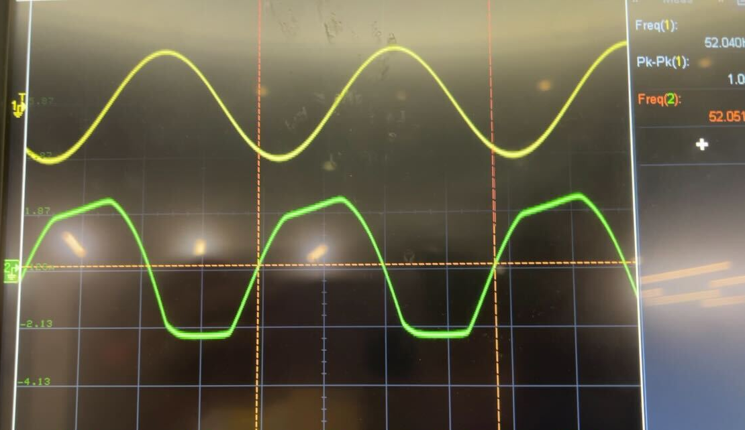
What you should expect to see...
For questions/comments on this circuit and workshop, contact:
Antonia (Toni) Rabisheva
~
arabisheva3@gatech.edu

